Slide 1
How to create a virtual machine.
Made by:
Magro Luca, Morin Baptiste, Lefebvre Romain

Slide 2
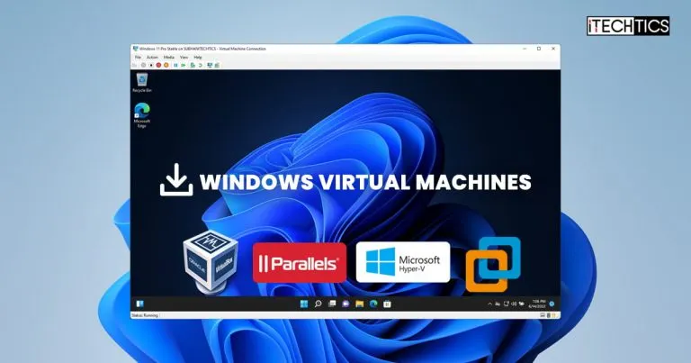
what is virtual box ?
-virtual machine
-simulate a computer(iut)
-sandbox
-share ressources
-free

Slide 3
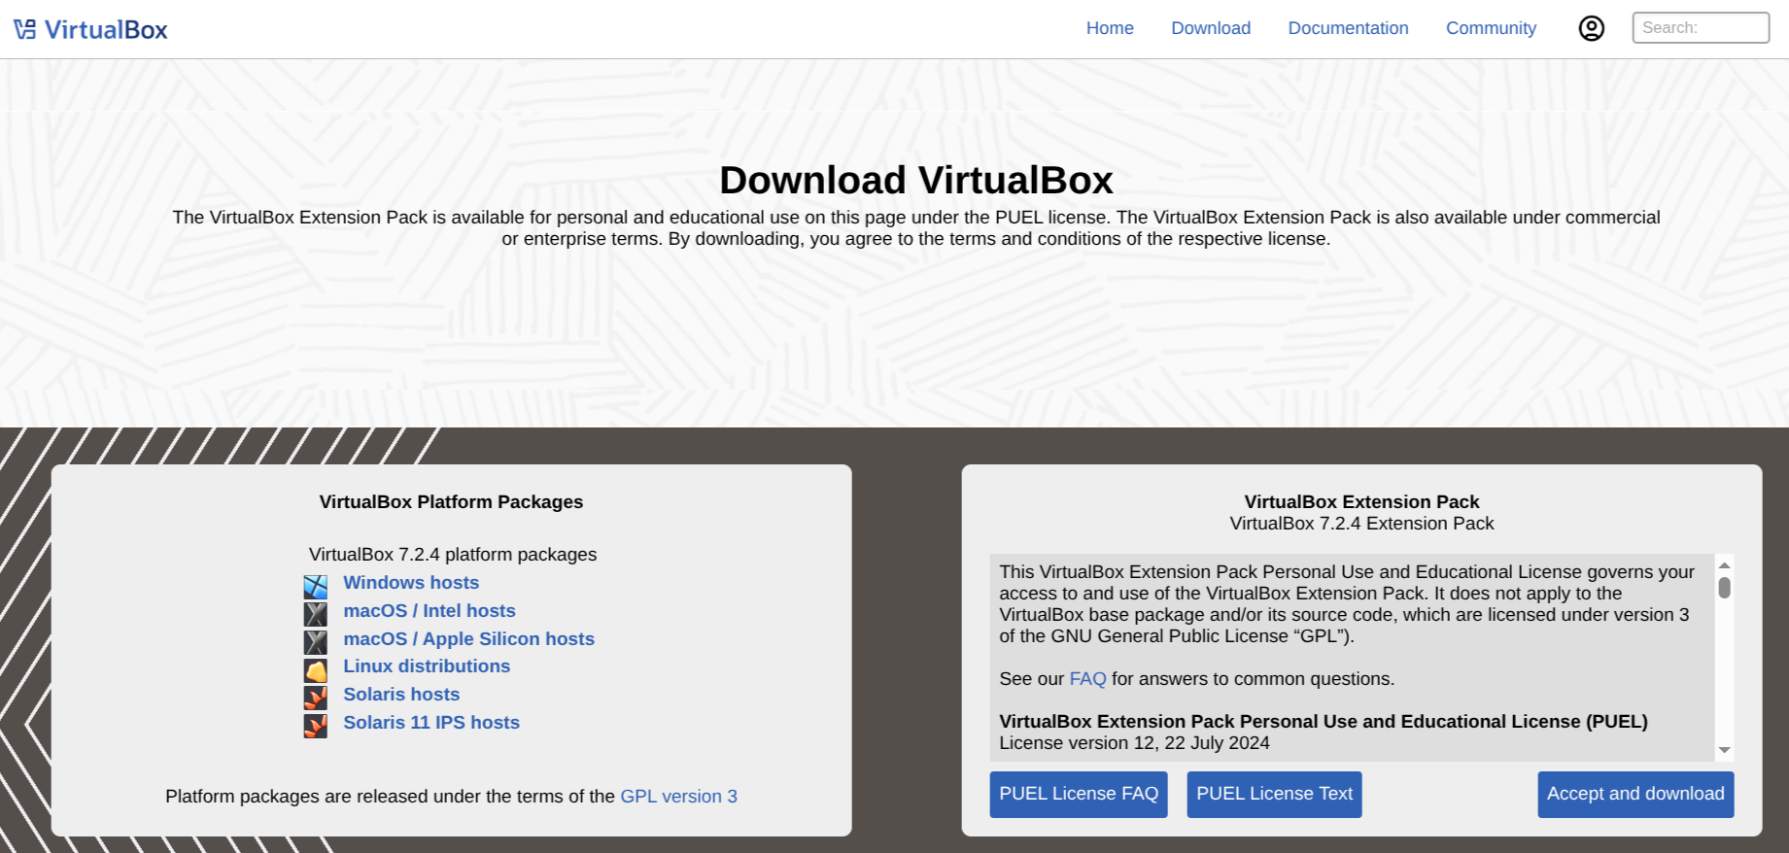
what to download?
Oracle Virtual box
Debian .iso file

Slide 4
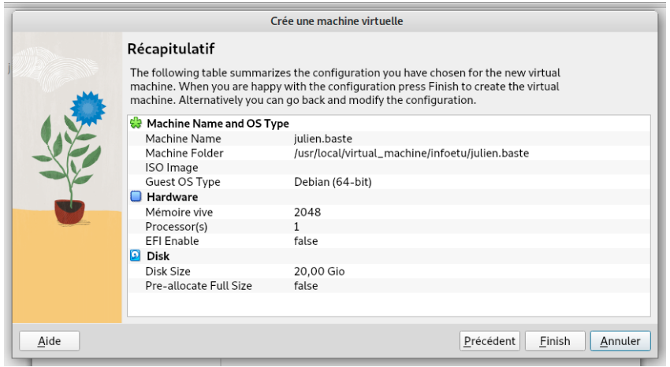
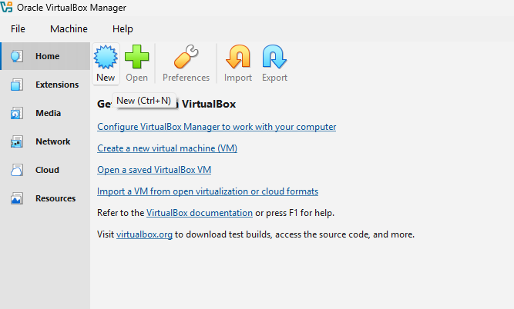
Creating the virtual computer

Slide 5
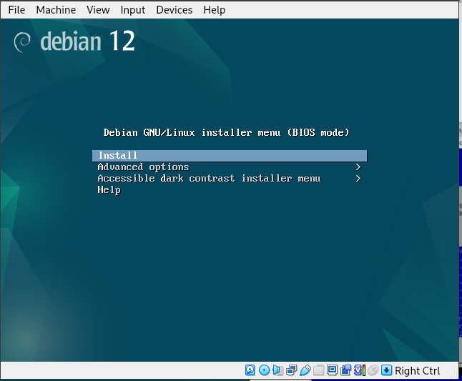
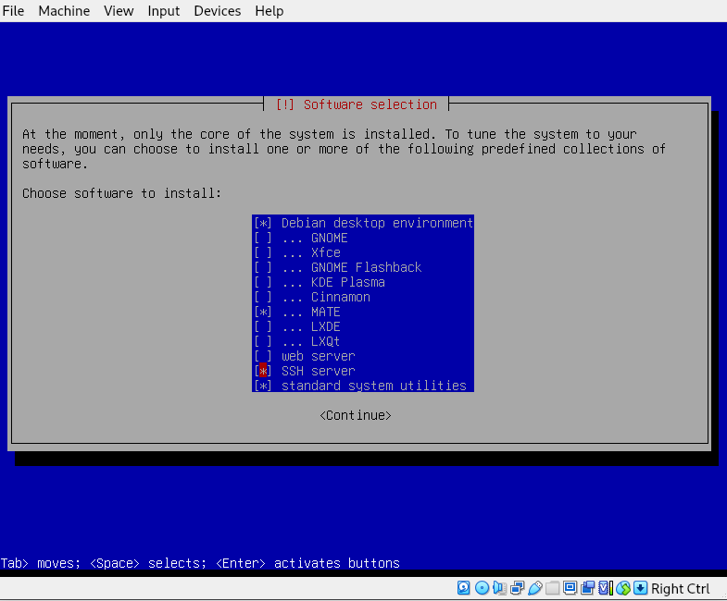
Installing the operating system
-Language
-Root
-User Account

Slide 6
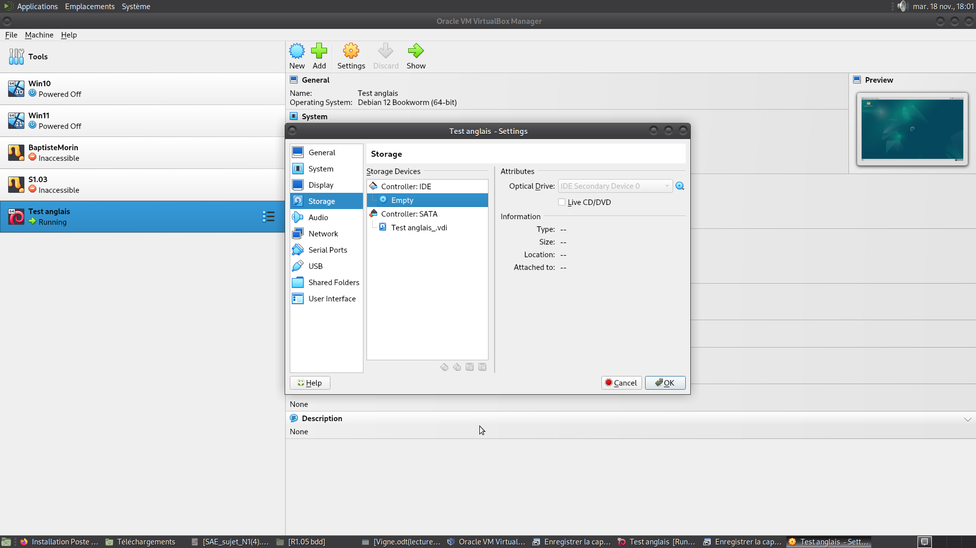
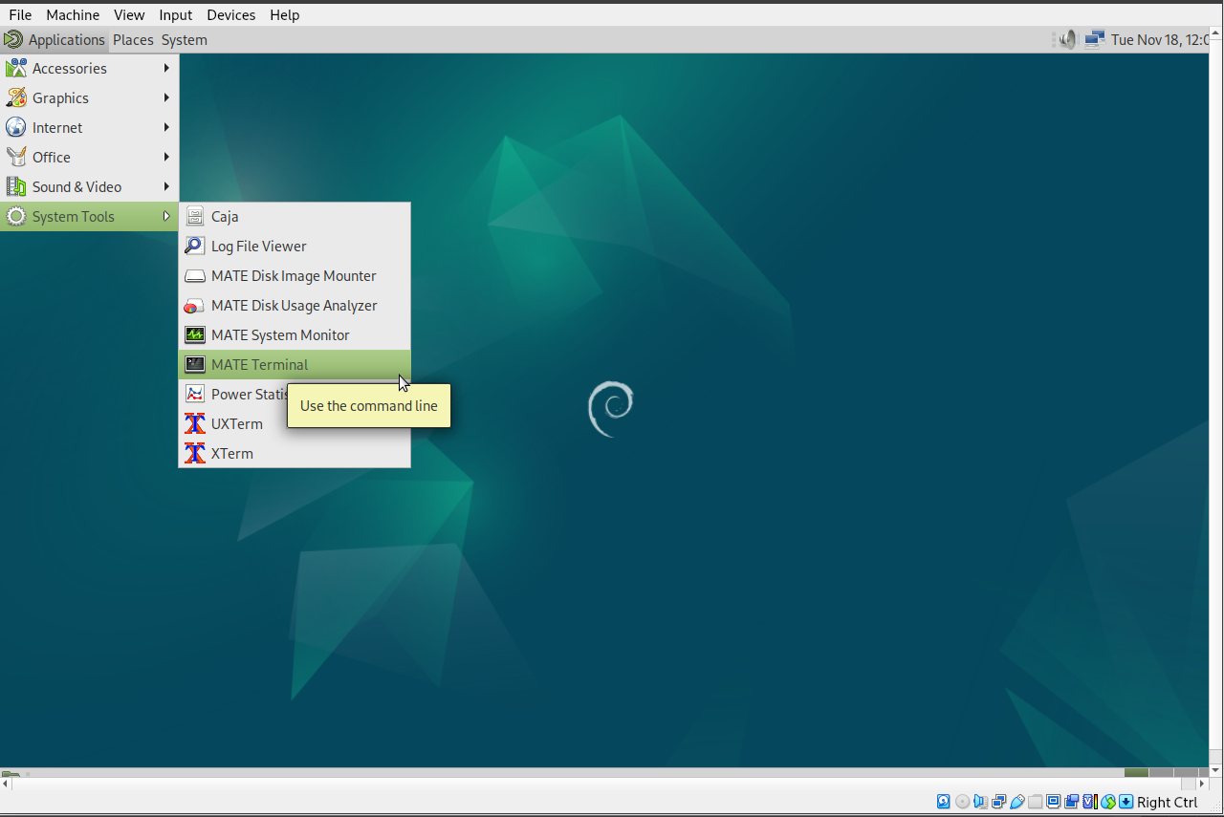
Making the computer useful

Slide 7
su -
wget https://env.iutinfo.fr/config-virtualbox
source config-virtualbox
usermod -aG sudo “VotreNomDeCompte”

